Slide 1


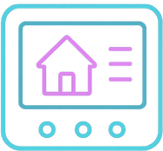
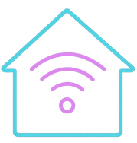

home automation system
afif/miloud

Slide 2
home automation system
afif/miloud

Slide 3
Introduction
Home Automation System Use Smart Device To Control Functions.
It Ensure The Comfort , Reduces Energy , And Time Consumption Of The User.

Slide 4
FUNCTIONAL REQUIREMENTS:
USER AUTHENTICATION
REMOTE CONTROL
AUTOMATION ROUTINES
REMOTE MONITORING
VOICE CONTROL INTEGRATION

Slide 5
NON-FUNCTIONAL REQUIREMENTS:
USER-FRIENDLY INTERFACE
SCALABILITY
EFFECTIVENESS
SECURITY
RELIABILITY
COMPATIBILITY

Slide 6
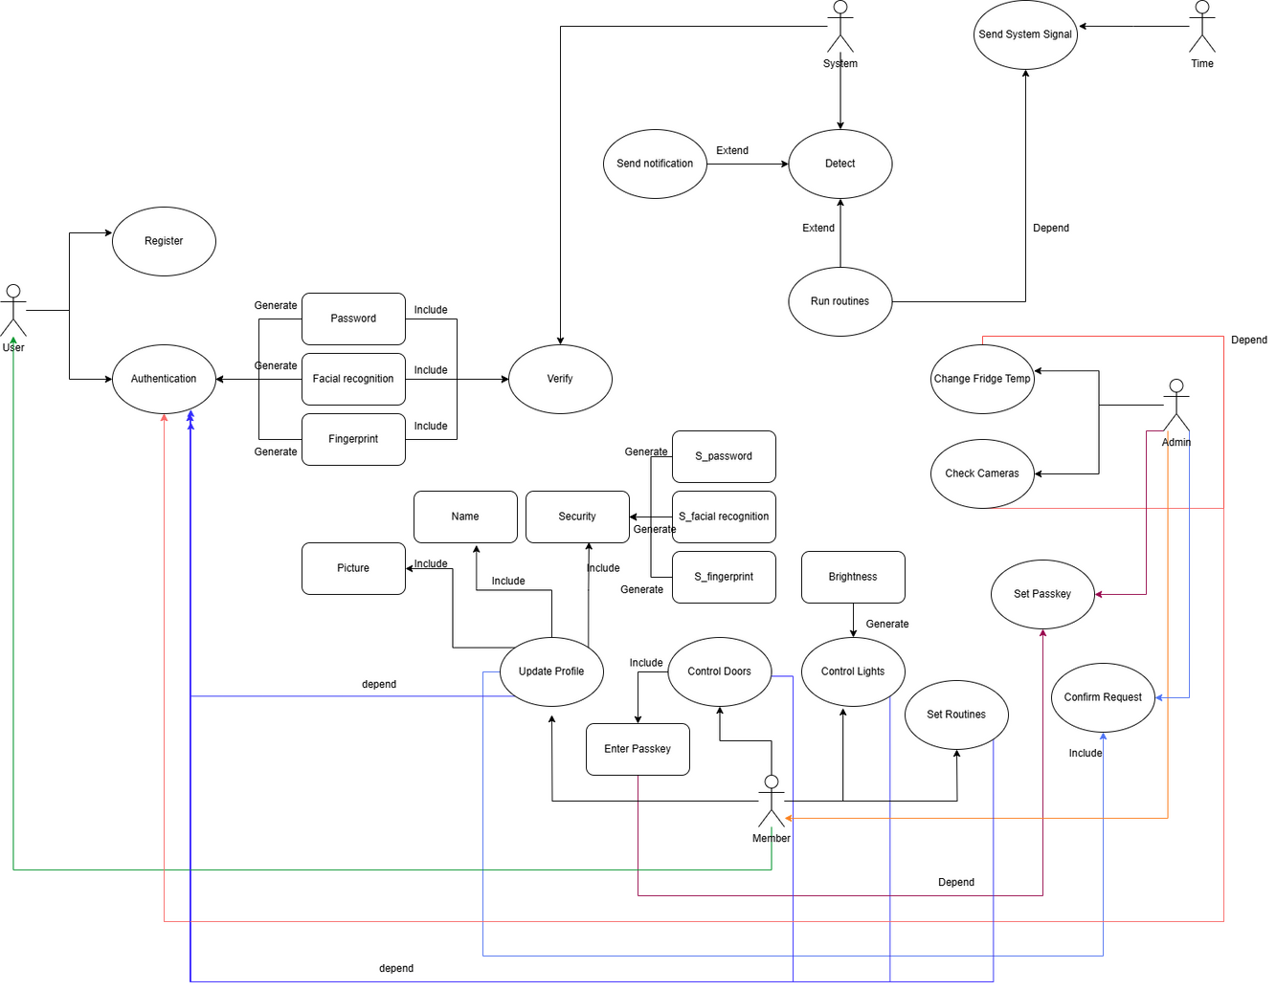
usecase-diagram

Slide 7
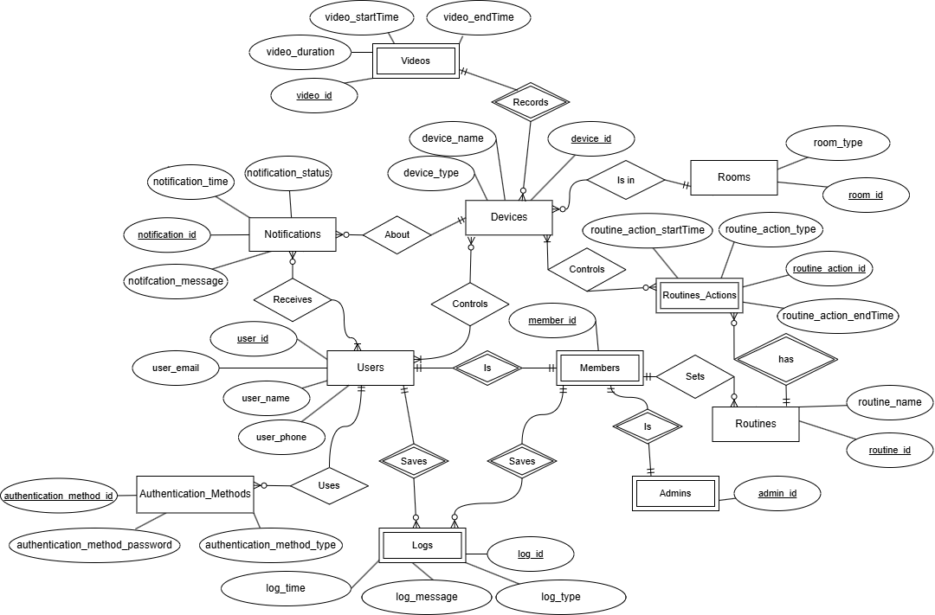
ERD

Slide 8
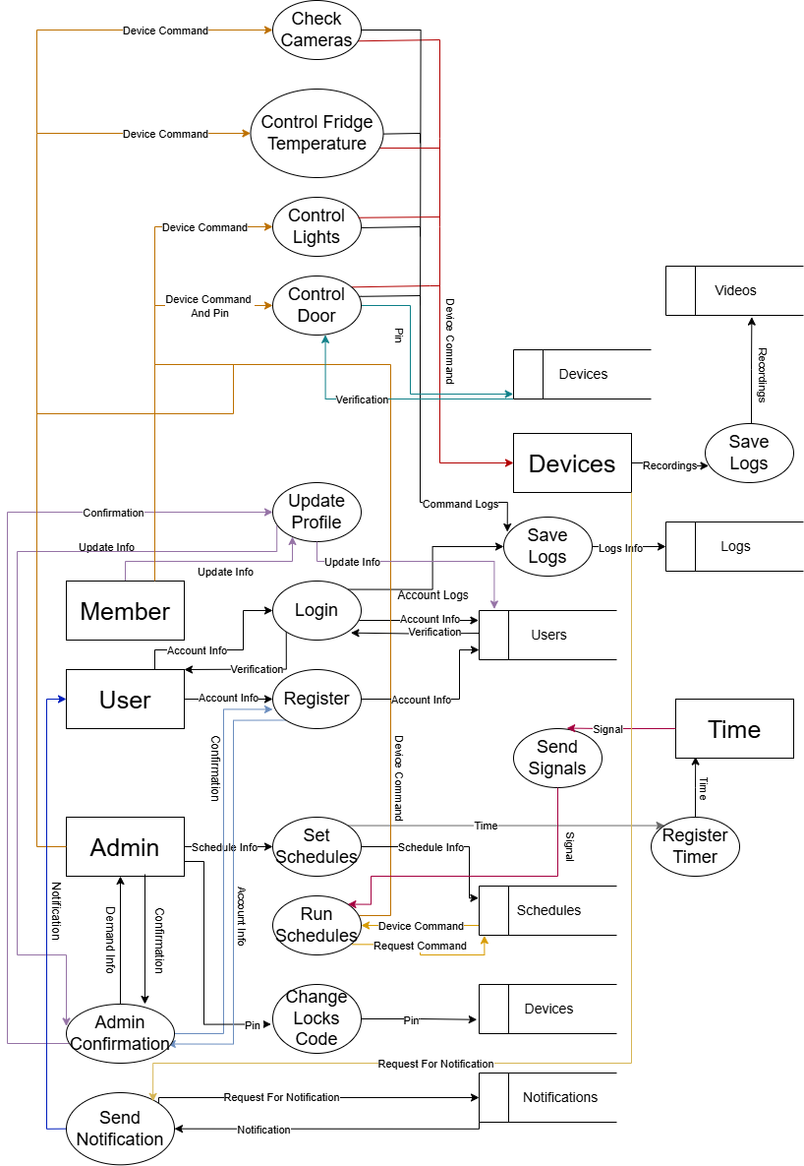
DFD

Slide 9
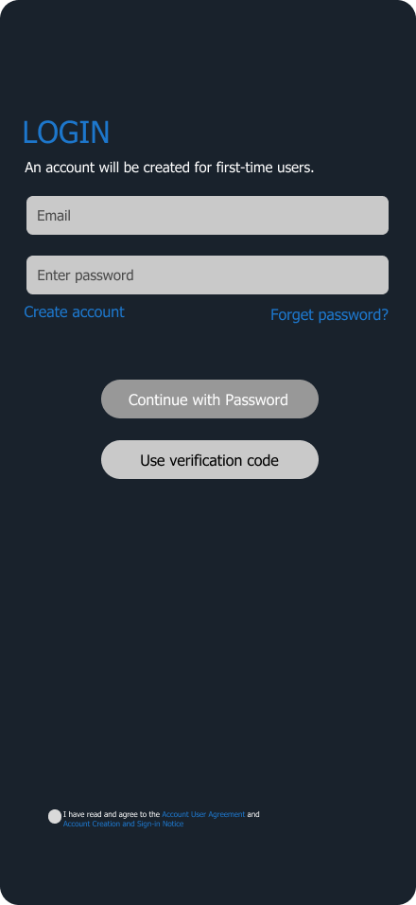
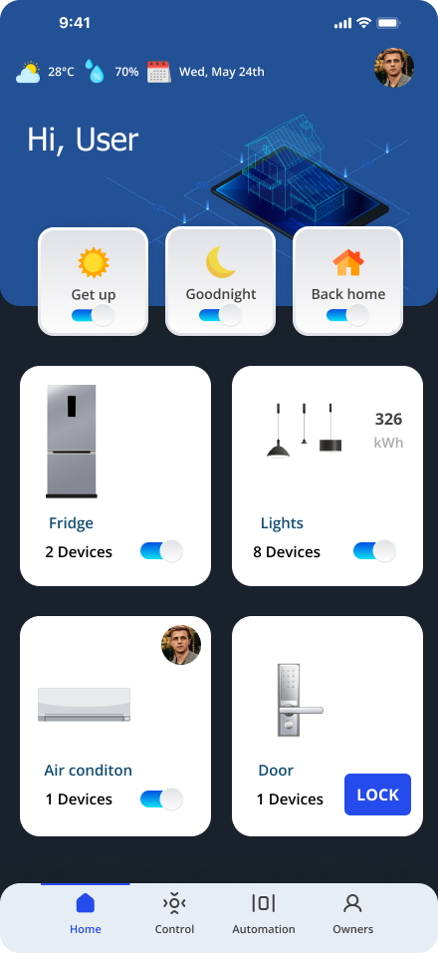
UI:Login/main Interface

Slide 10
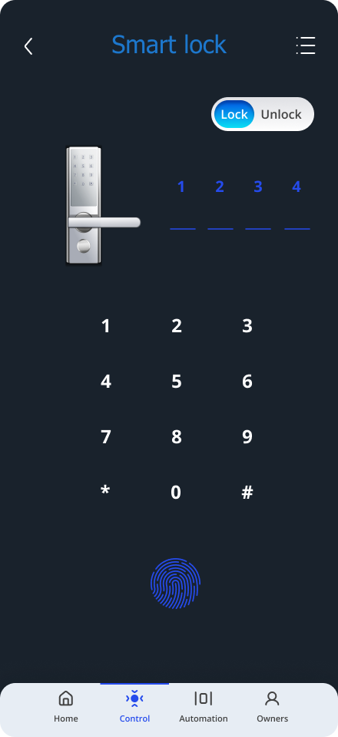
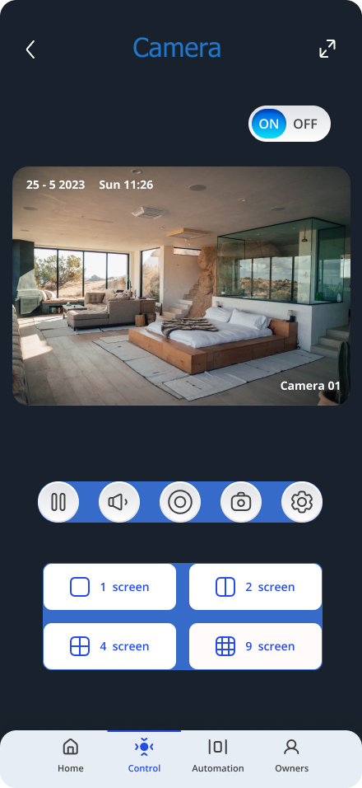
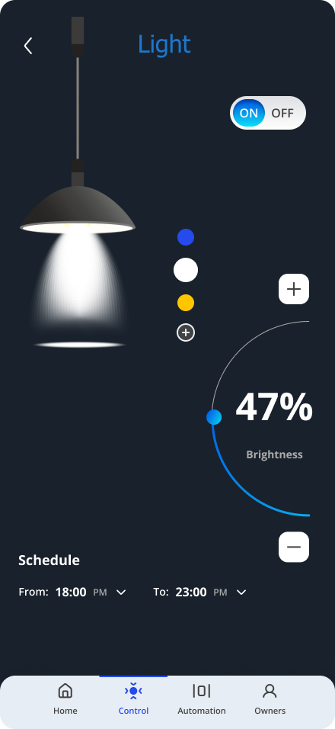
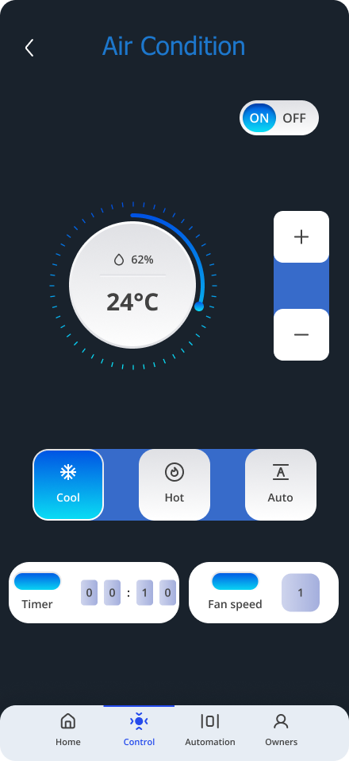
UI:remote control

Slide 11
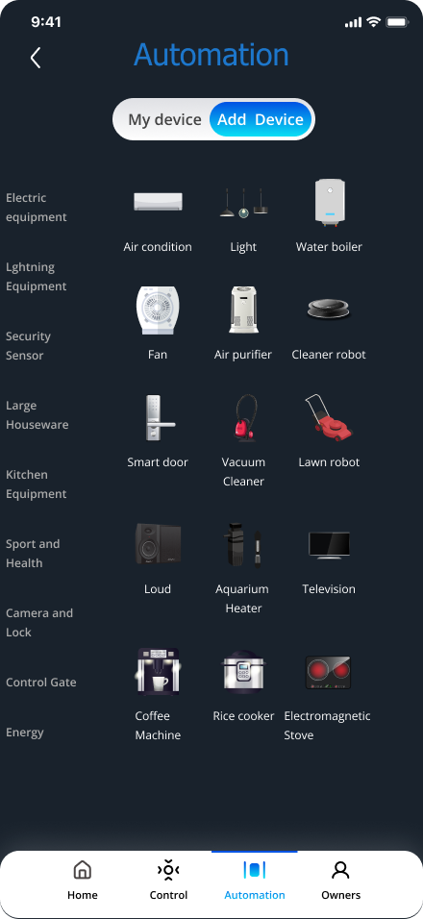
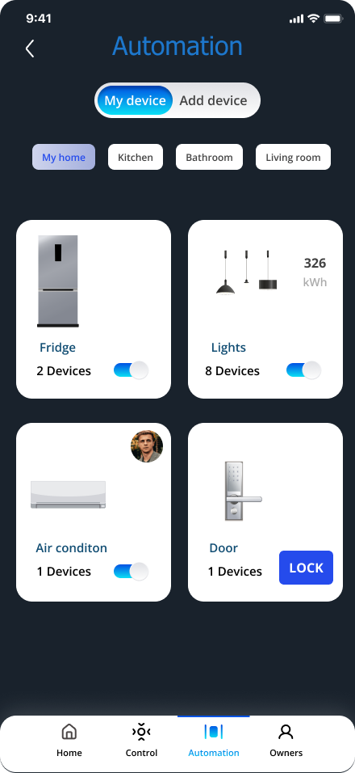
UI:automation

